Slide 1
Legos, Language and Literacy
Cambio de Colores
Marlow Barton MELL Instructional Specialist
mbarton@edplus.org
bartonmarlow@gmail.com

Slide 2
Agenda
What is Language Experience Approach (LEA)?
Differentiating for various levels of English Proficiency
Create a shared story using lego kits to illustrate.
Take pictures, post as a google.doc or google.pptx, and share with Marlow:
mbarton@myedplus.org

Slide 3
Language Experience Approach
The Language Experience Approach (LEA) combines all four language skills (SWRL):
speaking
writing
reading
listening
Working on the four language skills side by side aids fluency.
An LEA lesson is centered around a learner-generated text. The rationale behind LEA is that materials with familiar vocabulary and ideas are more meaningful and accessible than texts found in pre-prepared books. For teachers wanting to work on reading fluency with emergent readers, learner-generated texts are ideal.

Slide 4
STEP #1: A Shared Experience
The LEA process begins with something the class or small group does together:
a field trip
an experiment
other hands-on activity … like Lego stories!
If this is not possible use:
a sequence of pictures (that tell a story)
a student describing a sequence of events from real life.

Slide 5
STEP #2: Creating the Text
Next, the teacher and students, as a group, verbally recreate the shared experience.
Students take turns volunteering information (or adding a line to the story), as in a large-group discussion.
The teacher (or group scribe) transcribes the student’s words on the board in an organized way to create the text.

Slide 6
STEP #3: Read & Revise
The class reads the story aloud chorally or with a buddy and discusses it (avoid round robin reading).
The teacher (or group leader) asks if the students want to make any corrections or additions to the story, marks the changes they suggest and makes further suggestions, if needed.

Slide 7
STEP #4: Read and Reread
The final story can be read in a choral or echo style, or both. Students can also read in small groups or pairs, and then individually.

Slide 8
STEP #5: Extension
This text can be used for a variety of literacy activities:
Illustrations (or more Lego Scenes!)
Print the story with blanks to create a CLOZE activity.
Creating comprehension questions
Word or letter hunts (not word search or crossword puzzle)
Copy sentences or phrases and match them to the chart story
Sentence sequencing
Sentence combining
(See this link for more ideas on extension or small group activities with Language Experience Approach.)

Slide 9
You are now an ELL!
Pretend to be an ELL who is the proficiency level of the strip you were given. When it is your turn to say your part of the story be sure to either say a word, phrase, or sentence depending upon your level.”

Slide 10
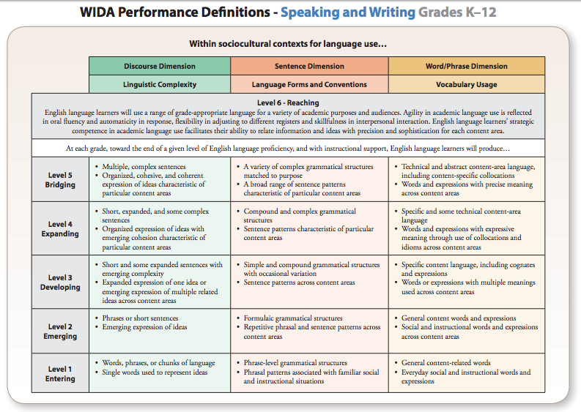
Differentiating for levels of English Proficiency
WIDA Performance Definitions - at www.WIDA.us

Slide 11
Now it’s your turn - In a group of four:
Step 1 - A Shared Experience (5 minutes)
Pick your favorite story starter. Then work together to create a “Lego Scene” related to your story starter.
Step 2 - Creating the Text (8 minutes)
Assign someone to be the scribe who will open a google.doc to type the group’s story. Take turns orally adding a line to the story role-playing your assigned WIDA Performance Definition level. It’s essential that everyone add a line even if it’s very short.
Step 3 - Read & Revise (2 minutes)
Each person confirms or has the scribe edit their own line.
Step 4 - Read & Reread (5 minutes)
Take a picture of your scene and add it to the Google.doc where you have typed your story and share it to dcole@myedplus.org Prepare to read aloud the story to the large group (chorally, in pairs, or individually)
Notes:
Poster paper is also available for those who don’t want to do a google.doc

Slide 12
Share your pictures and stories!
Notes:
Marlow

Slide 13
Next Steps:
Extension Activities page 10
Legos Downloads
See the next few slides to review LEA

Slide 14
Source: Christy Ann A. Lecuesta

Slide 15
Source: Christy Ann A. Lecuesta

Slide 16
Remember:
“What I can think about, I can talk about.”
What I can say, I can write.”
What I can write, I can read.”
“I can read what I can write and what other people can write for me to read.”
Roach Van Allen

